Slide 1
Concentrating the Urine
Prof. Deepthi de Silva
Department of Physiology

Slide 2
At the end of this lecture, you should be able to
Define osmolality and differentiate it from osmolarity
Outline the need for a mechanism for concentrating urine
Outline the structure of the countercurrent multiplier system and the vasa recta and state the type of nephrons that are involved
Outline the mechanism of action in the juxtaglomerular nephron’s countercurrent magnifier
Outline the role of urea in the formation of a hypertonic renal medullary interstitium
Outline the importance of antidiuretic hormone (ADH) in concentrating urine

Slide 3
Some revision.....
Concentration
high
Concentration
low
Osmosis- passage of water through semi-permeable membrane from less concentrated to more concentrated solution
Osmotic pressure- pressure needed to oppose osmosis
  Indirect measure of osmolarity of a solution

Slide 4
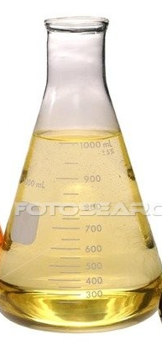
Osmolality vs Osmolarity
Filled up to
1 Litre
Osmolarity- molar concentration of solute particles/L of solution
Osmolality - molar concentration of solute particles/kg of water
180g
glucose
+ 1 Litre
180g
glucose

Slide 5
Has to be maintained
Normal plasma osmolality
  280-296mOsmol/kg water
  2([Na ⁺]+ [K ⁺]) + Urea + Glucose
Urine osmolality
mmol/L
  30-1400mOsmol/kg water

Slide 6
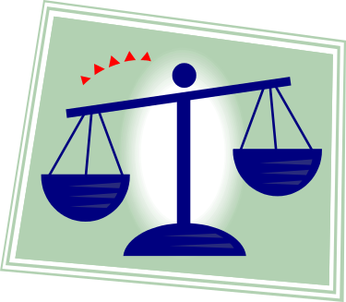
Water balance
Intake of water
Via drinking, food, metabolism
Drinking of water is the most important physiologically
  it can be regulated by sense of thirst
Loss of water
Via kidneys, stool, sweat, breath
Renal loss of water is most important physiologically
  can be regulated via ADH

Slide 7
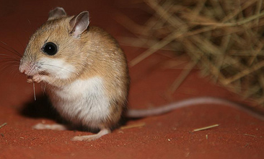
The Australian desert mouse
Adapted to life in desert
‘no water’ except in food & from metabolic activity
Produces concentrated, low volume urine that is 10,000 mOsmol/kg H₂O

Slide 8
What happens in Humans?
Need to excrete around 600mOsm/day especially urea
  if max concentrating ability is 1200mOsm/L
Need to excrete at least 0.5L water/day [obligatory urine volume]

Slide 9
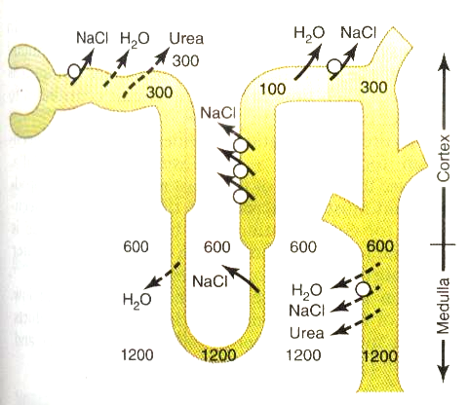
Ascending limb
Transport
Na+, Cl-, K+
‘Impermeable’ to water
Descending limb
Permeable to water
Not to solute

Slide 10
What happens?
Hypotonic fluid leaves the distal convoluted tubule to enter the collecting ducts
The collecting ducts pass from the renal cortex to the medulla
Gradient of osmolarity occurs in the kidney
  the medulla has high osmolarity compared to the cortex
Under the influence of a hormone (ADH), water moves out of the collecting duct using its osmotic gradient

Slide 11


100 mOsm
300
mOsm
Cortex
300
mOsm
water
Outer
medulla
600
mOsm
Collecting duct
water
Inner
medulla
1000
mOsm
water

Slide 12
Role of Anti Diuretic Hormone
ADH controls the permeability of the Collecting Ducts to water
  Without ADH the permeability of collecting duct to water is minimal
When ADH is present
  Aquaporin 2 channels active
  Water reabsorbed
    Cortical and medullary portion of CD

Slide 13
What is required to form this osmolarity gradient?
Counter current multiplier system of the nephron
Antidiuretic hormone (ADH or vasopressin)
  Increase urea reabsorption at the loop of Henle

Slide 14
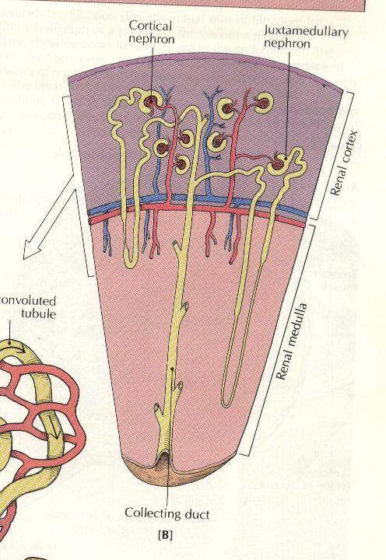
Countercurrent multiplier system
Cortical
nephron
Juxtamedullary
nephron
Involves the juxtamedullary nephrons (15% of nephrons)
Create osmotic gradient
  Medulla > Cortex
Renal Cortex
Renal Medulla
Collecting duct

Slide 15
Countercurrent multiplier
‘Countercurrent’
  flow in the descending and ascending tubules occur in opposite directions

Slide 16
Ascending limb
Transport
Na+, Cl-, K+
‘Impermeable’ to water
Descending limb
Permeable to water
Not to solute

Slide 17
Water
Filtrate entering loop of Henle is iso-osmolar (300mOsm/L)
Water reabsorbed in descending limb
Osmolarity increased (upto 1200-1400 mOsm/L)
1200

Slide 18
NaCl
In the ascending limb, solute (mainly NaCl) reabsorbed
  - Water remains in the tubule
Fluid becomes
hypo-osmolar 100mOsm/L
1200

Slide 19
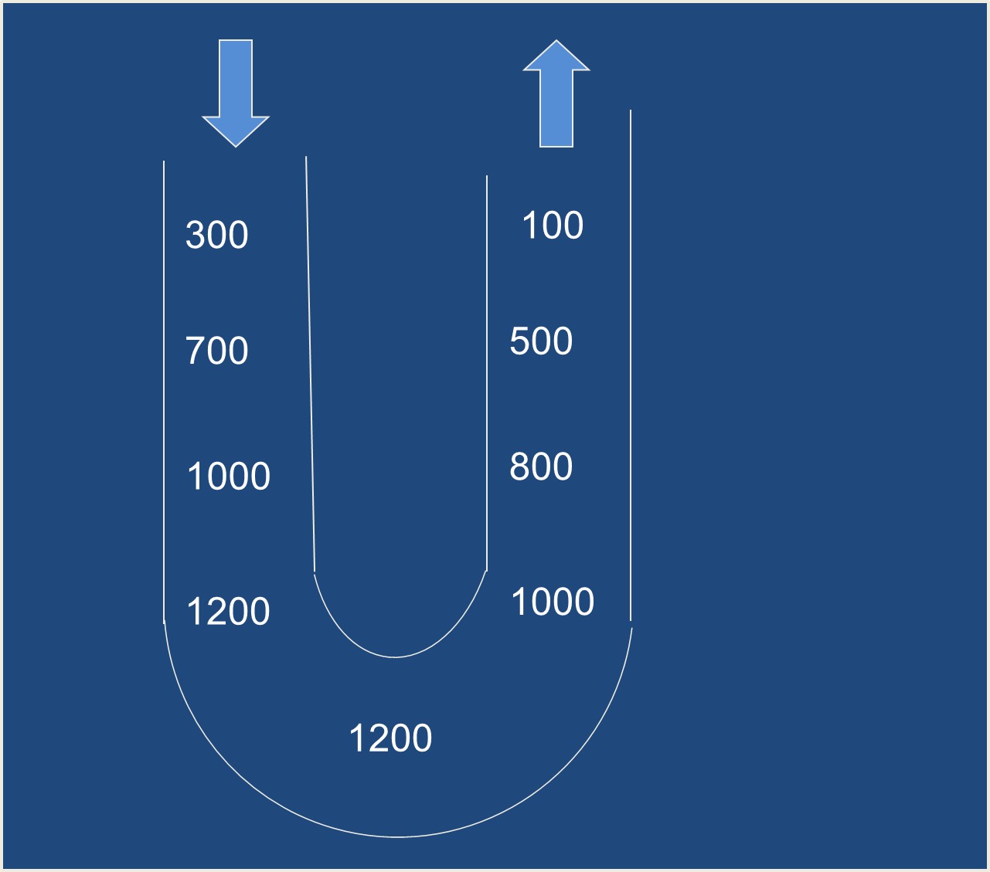
Water
NaCl

Slide 20
Countercurrent multiplier
Repetitive reabsorption of NaCl by the thick ascending loop of Henle
  AND
Continued inflow of new NaCl from the PCT to the loop of Henle
Causes ~ 200 mosmoles difference in concentration gradient at each level between the ascending & descending limbs ‘Countercurrent multiplier’

Slide 21
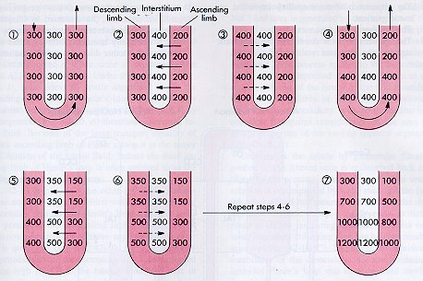

Slide 22
Maintaining the osmotic gradient
The concentration gradient formed by juxtamedullary nephrons has to be maintained
The Vasa recta (Countercurrent Exchangers) remove water and solute without altering the interstitial fluid concentration gradient

Slide 23
Vasa Recta
U shaped & parallel to loop of Henle
Two important functions
  1. Providing nutrients and oxygen to tubules in the medulla
  2. Maintaining medullary interstitial osmotic gradient.
  PASSIVE PROCESS – ceases if countercurrent multiplication stops

Slide 24
Vasa Recta
Capillaries
Freely permeable to water and solutes
Equilibrate with the surrounding interstitial fluid
Descending limb of vasa recta
  Solutes move in and water moves out
Ascending limb of vasa recta
  Solutes move out and water moves in

Slide 25
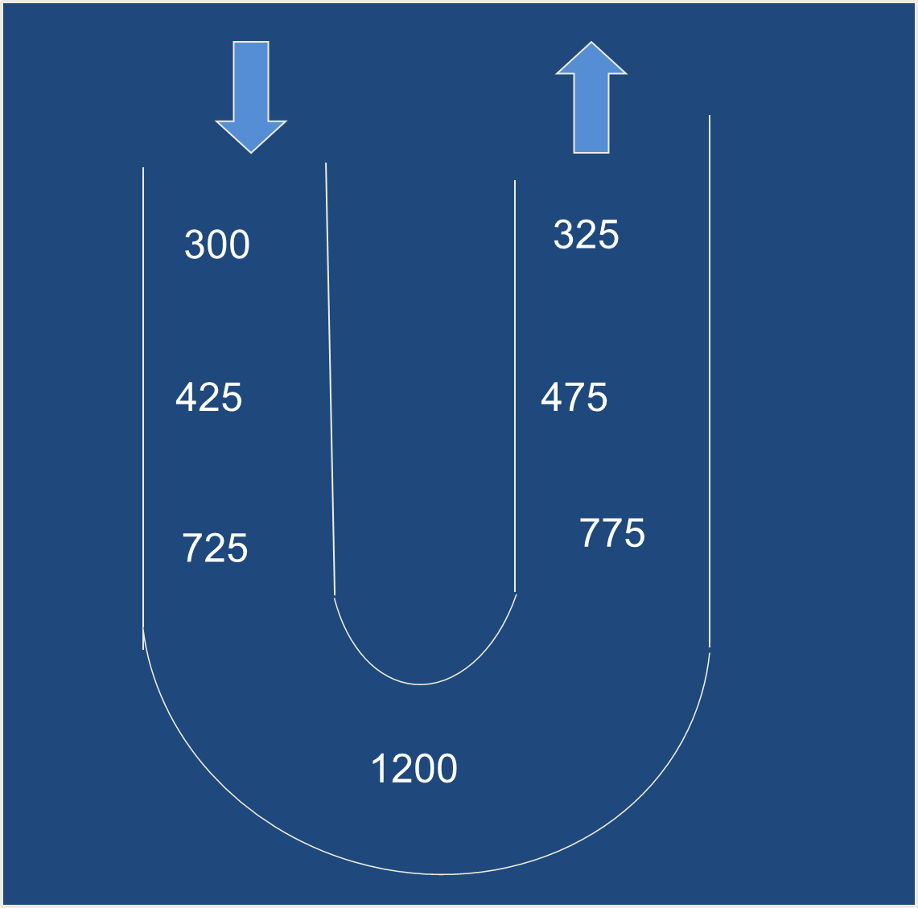
Water
NaCl
Water
NaCl, Urea

Slide 26
Role of Urea in concentrating Urine
Urea recirculation provides an additional mechanism to form hyperosmotic renal medulla
Urea moves passively out of inner medullary portion of the CD to medullary interstitium
  Facilitated by ADH acting on urea transporters
Some of the reabsorbed urea diffuses back into the descending limb & thin ascending limb
Recirculation of Urea
High protein diets can help concentration of urine

Slide 27
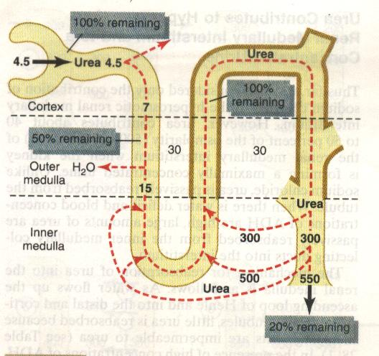
100% remaining
100% remaining
50% remaining
20% remaining

Slide 28
Summary of water reabsorption
PCT: 65% water reabsorbed with solute; iso-osmolar fluid
Descending limb: water reabsorbed to form more concentrated fluid (upto 1200mOsm/L)
Ascending limb (thin): some NaCl reabsoption; impermeable to water; urea enters tubular fluid
Ascending limb (thick): solute reabsorbed forming dilute solution (100mOsm/L)
Proximal DCT: further NaCl reabsorption
Late DCT and cortical collecting duct (CD) dependent on ADH for water reabsorption
Medullary CD: water reabsorbed under ADH influence and dependent on interstitial fluid concentration; concentration of fluid upto 1400mOsm/L

Slide 29
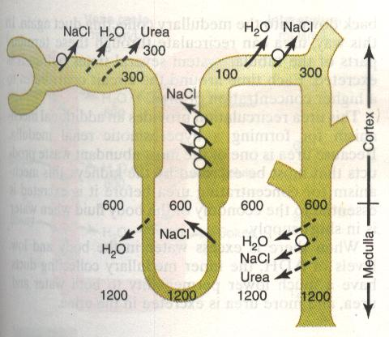

Slide 30
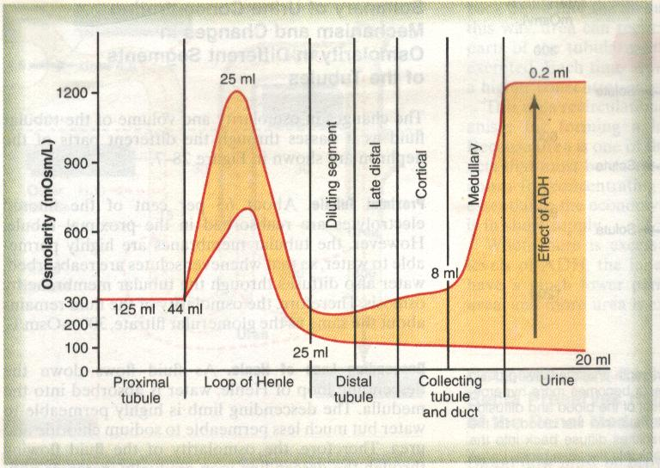
25mL/min
0.2mL/min
125
mL/min
44mL/min
20
mL/min
25mL/min

Slide 31
